Slide 1

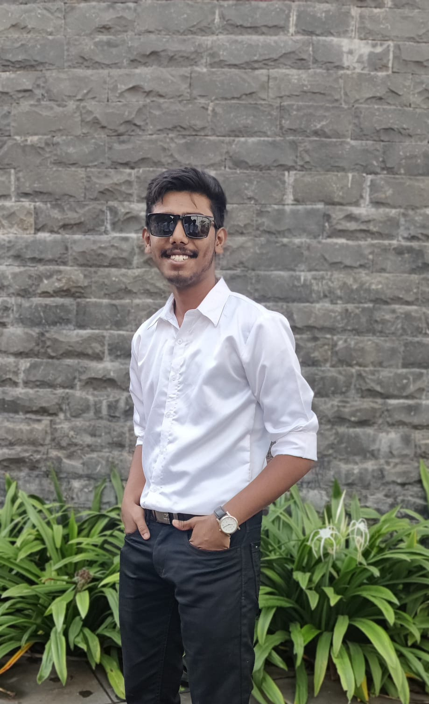
Name :- Atharva C Gaikwad
SkillBuild Email Id :- atharvagaikwad1907@gmail.com
College Name :- AISSMS Institute of Information Technology
College State :- Maharastra
Internship Domain :- Cyber Security
Internship start and end Date :- 13 Oct 2023 - 3 Nov 2023

Slide 2


PROJECT TOPIC
Hiding Message In An Image

Slide 3


AGENDA
1.Project Overview
2.About Target Audience
3.Solution
4.Features of Project
5.Modelling
7.Important Links
6.Results

Slide 4


PROJECT OVERVIEW
Overview
This project aims to implement a Python-based application for hiding messages within images using steganography. Instead of sentiment analysis, the focus is on encoding and decoding hidden messages within image files. The application will utilize machine learning techniques to embed and extract information from images.

Slide 5



The project focuses on steganography, a method of hiding messages in images, and is aimed at various audiences. These include cybersecurity professionals, privacy advocates, app developers, digital forensics experts, ethical hackers, educational institutions, individuals interested in privacy tools, communication security enthusiasts, security researchers, and businesses needing confidential communication. The project’s promotion should highlight its practical applications and benefits for these specific groups.

Slide 6





Project Solution Overview:
Developed a Python-based steganography tool using tkinter and PIL for secure message hiding in images. Features include an intuitive interface, text encoding/decoding, and user prompts.
Security Measures:
Utilizes steganography to subtly modify pixel values, ensuring secure information concealment within images.
Ease of Integration:
Modular structure allows seamless integration into existing projects or systems, enhancing information transmission security.

Slide 7
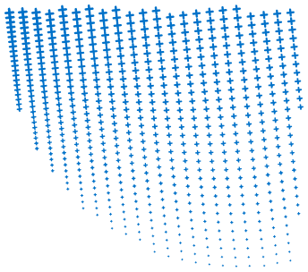
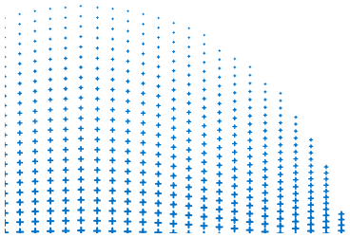
Features of Project
User-Friendly Interface
Image Selection and Processing
Text Encoding and Decoding
Feedback and Alerts
Modular Structure for Integration

Slide 8


The project is a Python-based Image Steganography tool utilizing tkinter and Pillow. It features a user-friendly interface for encoding and decoding messages in images. Steganography techniques are applied to subtly modify pixel values, ensuring secure information concealment. Users can select images, encode text messages, and decode hidden messages. The system provides informative feedback and alerts. The modular structure allows seamless integration into existing projects, enhancing information transmission security.

Slide 9


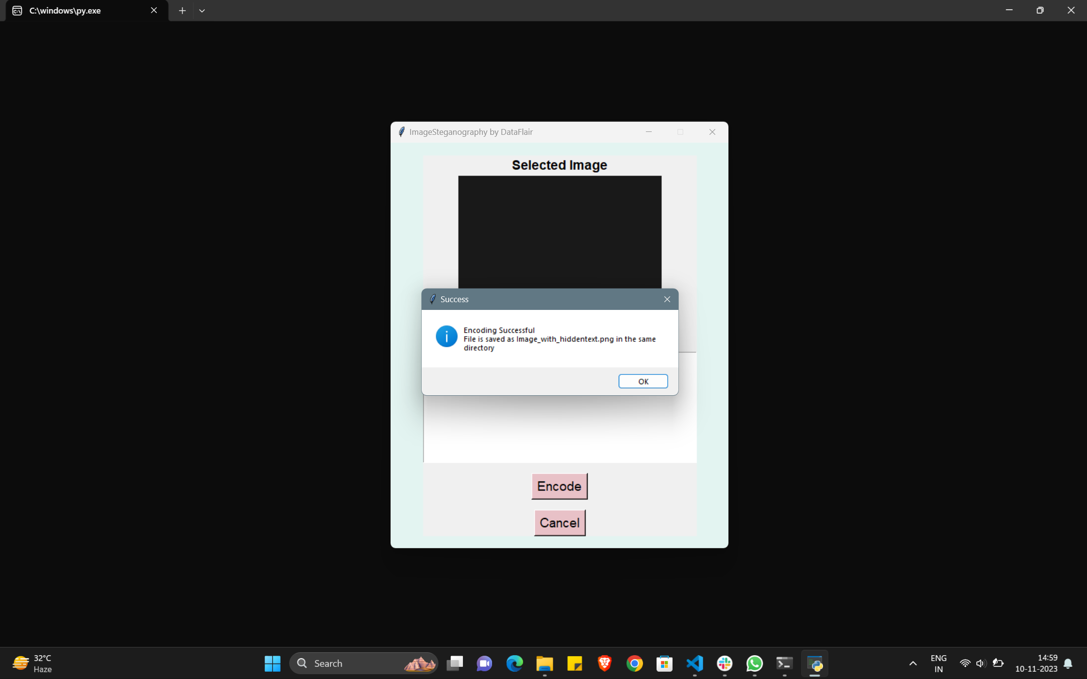
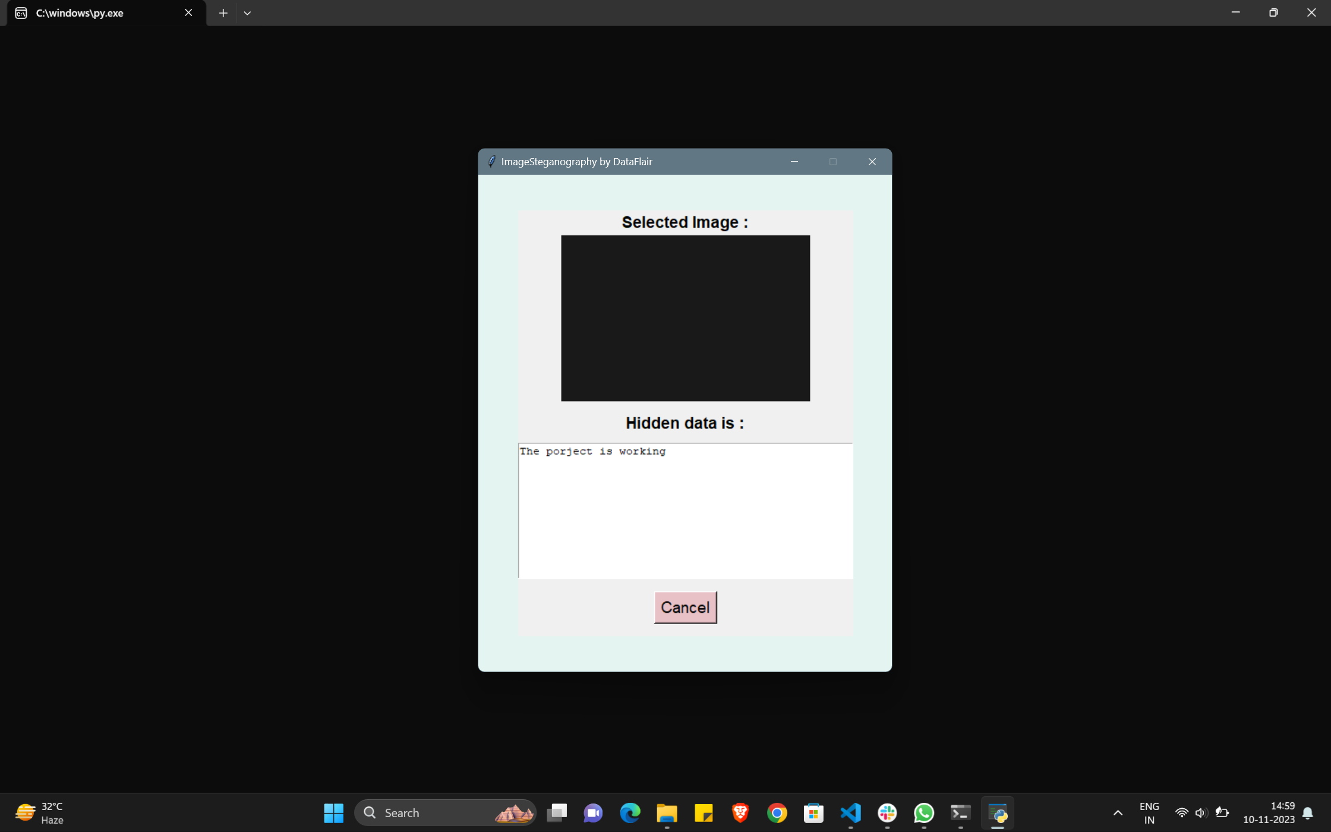


Slide 10
Encoding code
Decoding code
def encode_frame2(self, e_F2):
# ... (existing code)
e_pg = Frame(root)
# Existing code for selecting image, displaying, and getting user input
encode_button = Button(e_pg, text='Cancel', command=lambda: IMG_Stegno.back(self, e_pg))
encode_button.config(font=('Helvetica', 14), bg='#e8c1c7')
encode_button.grid()
# Existing code for getting user input and saving the new image
button_back = Button(e_pg, text='Encode', command=lambda: [self.enc_fun(text_a, my_img), IMG_Stegno.back(self, e_pg)])
button_back.config(font=('Helvetica', 14), bg='#e8c1c7')
button_back.grid(pady=15)
# ... (existing code)
def decode_frame2(self, d_F2):
# ... (existing code)
d_F3 = Frame(root)
# Existing code for selecting image, displaying, and decoding hidden data
hidden_data = self.decode(my_img)
# ... (existing code for displaying hidden data)
button_back = Button(d_F3, text='Cancel', command=lambda: self.frame_3(d_F3))
button_back.config(font=('Helvetica', 14), bg='#e8c1c7')
button_back.grid(pady=15)
button_back.grid()
# ... (existing code)

Slide 11




https://github.com/ATHARVA8080/Hiding-Message-in-an-Image.git

Slide 12


